Slide 1

Thread Synchronization Visualizer(Producer-Consumer Model) Instructor – Dr. V Muniraju
Team 7:
D. Darishma – 2420030463
T. Naga Venkata Sree Vaishnavi – 2420030664
B. Akshaya – 2420030153
M. Spandana - 2420090150

Slide 2
INTRODUCTION
In modern computer systems, multiple processes and tasks are executed simultaneously using multithreading, which improves system performance and efficiency.
However, when multiple threads try to access a shared resource at the same time, it may lead to issues such as race conditions, data inconsistency, and unexpected system behavior.
To overcome these problems, Operating Systems use synchronization mechanisms like locks and semaphores.
This project focuses on demonstrating thread synchronization using the Producer–Consumer problem, which is one of the most important classical problems in Operating Systems.
The system also provides a real-time visual interface to help users understand how threads interact and coordinate with each other.

Slide 3
PROBLEM STATEMENT
In a multithreaded environment, multiple threads accessing a shared buffer can lead to:
Race conditions
Data corruption
Inconsistent output
For example:
A producer may try to add data when the buffer is already full
A consumer may try to remove data when the buffer is empty
Such situations cause system errors and inefficient performance.
Therefore, there is a need to design a system that ensures:
Proper coordination between producer and consumer threads
Safe access to shared resources
Efficient execution without conflicts

Slide 4
CORE OS CONCEPTS
Threads: Basic unit of execution used for parallel processing
Synchronization: Technique to control access to shared resources
Critical Section: Part of code where shared resource is accessed
Race Condition: Problem caused by simultaneous access to shared data
Semaphore / Lock: Tools used to ensure safe execution
Bounded Buffer: Fixed-size storage used in Producer–Consumer problem

Slide 5
OBJECTIVE
To design and implement a system that simulates the Producer–Consumer problem
To demonstrate the importance of thread synchronization in Operating Systems
To use synchronization techniques such as:
Locks
Semaphores
To visualize:
Buffer operations
Thread activity
System logs and statistics
To create an interactive tool that makes OS concepts easier to understand

Slide 6
METHODOLOGY
The system is developed using Python with multithreading and Tkinter GUI.
Multiple producer threads are created to generate data items continuously.
Multiple consumer threads are created to consume items from the shared buffer.
A bounded buffer (queue) is used as the shared resource.
Synchronization mechanisms are applied to:
Prevent buffer overflow
Prevent buffer underflow
Ensure safe access to the buffer
The GUI displays:
Real-time buffer status
Logs of produced and consumed items
System statistics

Slide 7
SYSTEM ARCHIRECTURE
System Architecture
The system is divided into different modules for better organization:
1. Producer Module
Generates data items and inserts them into the buffer
2. Consumer Module
Removes items from the buffer and processes them
3. Shared Buffer Module
Stores items temporarily with limited capacity
4. Synchronization Module
Controls access using locks/semaphores
5. User Interface Module
Displays buffer visualization, logs, and statistics
All these modules work together to simulate a synchronized system.

Slide 8
Execution Flow
User enters:
Producers, Consumers, Buffer size, Speed
On clicking Start:
Buffer is created
Producer and Consumer threads start
Producers:
Generate and add items to buffer
Wait if buffer is full
Consumers:
Remove and process items
Wait if buffer is empty
Synchronization:
Ensures safe access
Prevents race conditions
Real-Time Updates:
Buffer, logs, and stats update continuously
Simulation runs until Stop or Reset

Slide 9
TOOLS USED
Python
Main programming language used for implementation
Threading Module
Used to create and manage producer and consumer threads
Queue / Shared Buffer
Used as a bounded buffer to store items
Ensures FIFO (First-In-First-Out) behavior
Synchronization Mechanisms
Locks / Semaphores used to control access
Prevents data inconsistency
kinter (GUI Library)
Used to design the graphical user interface
Displays:
Buffer visualization
Logs
Statistics
VS Code / Eclipse (IDE)Used for coding, debugging, and testing

Slide 10
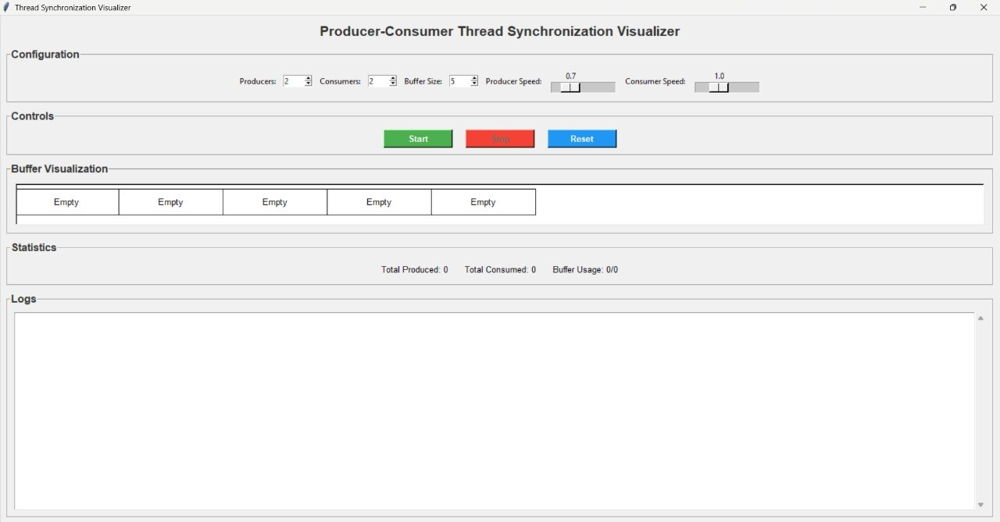
OUTPUT:

Slide 11
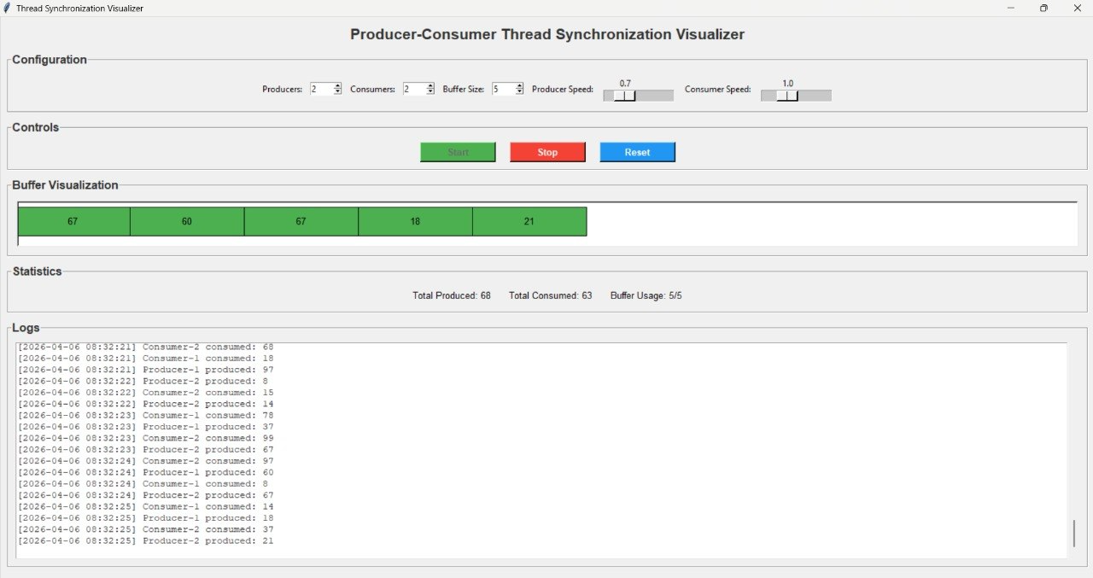

Slide 12
CONCLUSION
The project successfully demonstrates the Producer–Consumer problem, a fundamental concept in Operating Systems.
It shows how multiple threads interact with a shared resource in a synchronized manner.
By using synchronization techniques, the system avoids:
Race conditions
Data inconsistency
Unsafe access to shared memory
The visual interface makes it easier to understand:
Thread behavior
Buffer operations
Real-time system activity
Overall, the project provides a clear and practical understanding of:
Multithreading
Synchronization
Resource management in Operating Systems

Slide 13
THANK YOU

